Slide 1
Altrusa International, Inc. Leadership Development Committee 2019-2021
Simplifying Leadership

Slide 2
Being a leader is not about being in front. It’s about taking care of your team.
“The greatest leader is not necessarily the one who does the greatest things. He is the one that gets the people to do the greatest things.” – Ronald Reagan

Slide 3
What Are the Expectations?
What will work for your Club or District?
No “one size fits all”
If you have a small club, do you have to fill every role?
Expertise – what resources do you have? What are your members’ skills?
Organization?
Hands on planning?
Executing those plans?
Fund raising?
Outgoing – so willing to call on potential sponsors or donors?
Once you know your resources at hand – Delegate!

Slide 4
Delegation
“Are we limiting our success by not mastering the art of delegation? …. it’s simply a matter of preparation
meeting opportunity.” ~ Oprah Winfrey
Delegation is important for efficiency and development.
Empower your members!
Don’t burn out your leadership
Allow more members to learn new skills & feel a sense of contribution

Slide 5
Then How to Simplify?
“The most successful leaders were consistently focused on the things that really mattered. They were willing to back off even good ideas for the sake of simplicity and focus. Like master gardeners, they recognized that careful pruning would ultimately yield stronger, more sustained results.” ~ Steve Strelsin
Ways to Simplify Your Leadership
Don’t try to read minds.
Keep your word.
Life is too short to waste time being cranky.
Forgive everyone, even yourself.
Don’t try to please everyone.
Stop worrying about your mistakes.
Make time for what’s important.

Slide 6
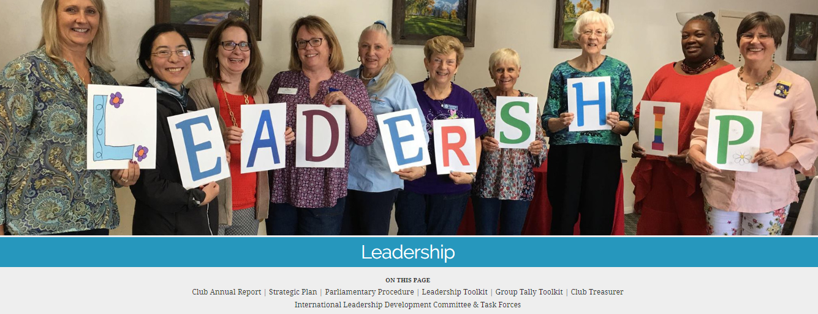
Leadership Tools:
International Website:
Leadership Tab

Slide 7
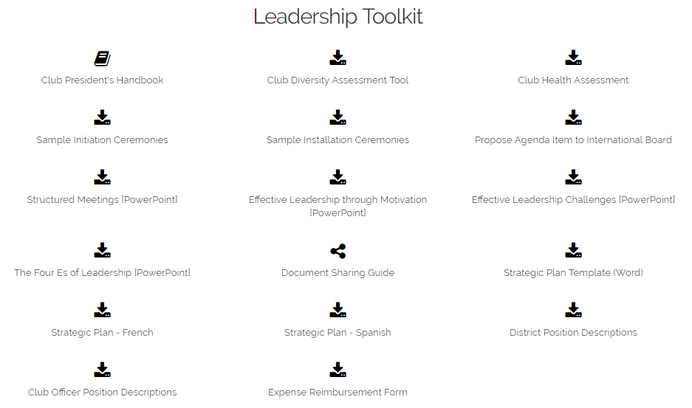
International Website:
Leadership Tab

Slide 8
Simplifying Succession Planning

Slide 9
What is Succession Planning?
Succession Planning is the process of identifying and developing new leaders who can move up and fill the rolls of those before them.
Simply put: Succession planning is planning for the future. Let’s face it….Life happens!

Slide 10
Seven Steps to Succession Planning
Be proactive with succession planning – Identify and mentor potential leaders within the club.
Keep an open mind – Assumption is a killer.
Make the vision known – Include new leaders in strategy conversations
Offer regular feedback to future leaders – acknowledge their ideas
Provide training – make sure they have the tools they need
Do a trial run of your succession plan – when you have a current leader absent, ask a future leader to step in.
Use your plan to develop/stay on track with Long Range Strategic Plan
Notes:
Proactive: Ask your members where they would like to be in the Club/District/International in 5 years. Be sure you direct them to attend workshops/training sessions for things they say they want to do. Connect a young leader with a seasoned member… past president/PG/PIP.
Open Mind: Don’t assume that the current secretary/treasurer or board member wants to move up and be in charge one day. And, don’t disregard someone that has not yet stepped up and assume they do not want to. Could be a timing thing. Take the time to discuss with your members in a relaxed atmosphere what they want to do.
Vision: Be sure to ask members to attend board meetings and planning sessions. Be sure the members know the vision and ask for input/buy in.
Feedback: Encourage involvement and expressing new ideas; provide a safety net; encourage the idea of planning for the future so that they may be willing to “promote” their new plan. Be willing to edit your plan along the way. This could be the “spark” that starts the fire!
Training: Make sure they have the tools they need to do their jobs. Make sure they have access to workshops/training sessions. This can also be accomplished by good mentoring partnerships. Make sure delegates to Conferences and Conventions are those that want to be leaders and will attend and participate.
Trial run: If a board member is going to be out for a board/club meeting, ask someone to step in for them. Maybe someone that has expressed a desire to move up the board….they may not be able to vote on a particular matter but they can always weigh in during discussion. Also, ask a current board member to step in for someone that is classified with a higher position on the board and fulfill their duties.
LRSP: Succession planning should be in the LRSP for your club, especially in the way of retaining and training members. Make sure that all members are aware of policies/bylaws and how your club handles events, etc.

Slide 11
John Maxwell’s Law of Leadership
The Law of Legacy states that a leader’s lasting value is measured by succession.
This Photo by Unknown Author is licensed under CC BY-SA-NC
Notes:
Succession planning and mentoring go hand in hand at every level. As an organization, we need to have our members “WANT” to move into leadership roles and lead us into the future. Relationships are key!

Slide 12
Simplifying Mentorship

Slide 13
Mentoring as a Pathway to Leadership
Result of the task force who worked in the 2017-2019 Biennium, surveying membership to see what the needs were and developing the manual based on those identified needs.
Goals of Mentorship
Program Overview

Slide 14
Goals of Mentorship
Engage new members and increase the retention rate of current Altrusa
Help Altrusans develop the skills, knowledge, and confidence to pursue leadership opportunities in Altrusa.
Create an environment that encourages Altrusans to accept leadership roles.
Share how building leadership skills helps in both Altrusa and personal lives.
Notes:
Develop to a better community through engaging new members and increasing the retention rate of current Altrusa members achieved through connections with members and the community.
Help Altrusans develop the skills, knowledge, and confidence to pursue leadership opportunities in Altrusa.
Create an environment that encourages Altrusans to accept leadership roles, knowing there is always someone there to discuss opportunities and challenges.
Share experiences on how building leadership skills help in personal growth, both in the club and at work.

Slide 15
Qualifications of Mentors
Active, knowledgeable member
Willingness to share with ability to listen
Previous leadership positions
Ability to encourage and provide constructive criticism
Can be someone other than sponsor
Prefer someone who has seen Altrusa beyond their club
Notes:
For all mentors:
Active member in your Club who is knowledgeable about Altrusa and how their club fits into their district and the International organization.
Willingness to share experiences and have the capacity to listen.
At least two leadership positions (including project or committee leadership) in Altrusa or their profession .
Knowledgeable on how to encourage.
Knowledgeable on how to provide constructive criticism.
Mentors should have knowledge of the job to which the mentee aspires. For example, a club president who has never attended a conference would not be a good mentor for someone who wants to get involved at the District level.

Slide 16
Qualifications of Mentors
Emerging leaders
Knowledge and experience with the position for which your mentee aspires.
Know your mentee
Willingness to “champion” mentee
Notes:
For emerging leaders:
Knowledge and experience with the position for which your mentee aspires. Your mentee may need to change mentors as she/he moves up in the organization to someone familiar with the position to which they aspire.
For mentees who are interested in leadership beyond the club level, the best mentors are those who have regularly attended conferences (or conventions, if the mentee is interested in serving at the International level).
The rest of the mentoring world refers to these folks as “sponsors”, which Altrusa defines differently. The champion recommends their mentee for new positions, introduces them to other people who can help them, and is willing to stake their reputation on the mentee’s ability to be successful.

Slide 17
For More Information
See the Altrusa Mentoring Guide
https://login.altrusa.org/mentoring-guide-05-2019/
Contains information on:
Programs benefits
How to pair mentors with mentees
Duties and responsibilities of both parties
Basic ground rules
Notes:
Note that these documents can be hard to find, but they come up if you search for them by name.
If we have an internet connection, it would be best to show what comes up with the links on this page and the next.

Slide 18
Optional On-line Forms
No current plan for international data for these
Clubs and districts may choose to use these
Altrusa Mentor Profile Form/Application
https://login.altrusa.org/files/2019/04/Altrusa-Mentor-Profile-Application-Form-fillable.pdf
Altrusa Mentee Profile Form/Application
https://login.altrusa.org/files/2019/04/Altrusa-Mentee-Profile-Application-Form-fillable.pdf
Notes:
Forms are to help connect mentors and mentees. They are NOT mandatory.
No international database is planned because nearly 90% of survey respondents said they wanted to work with someone in their club or district.
Clubs could use the forms for new members, especially in cases where the sponsor is a newer member with little Altrusa background. They would be of most use for larger clubs where people may not know each other well enough to make a match.
Districts could use them for emerging leaders, especially when the mentee has no one in their club with experience beyond the club. It’s also a way for districts to know who might be willing to serve a mentor.

Slide 19
Simplifying Strategic Planning

Slide 20
What is Strategic Planning?
Simply to set overall goals for your organization and develop a plan to achieve them.
“A strategic plan is a tool that provides guidance in fulfilling a mission with maximum efficiency and impact. If it is to be effective and useful, it should articulate specific goals and describe the action steps and resources needed to accomplish them. As a rule, most strategic plans should be reviewed and revamped every three to five years.”
- TCC Group Whitepaper, “Ten Keys to Successful Strategic Planning for Nonprofit and Foundation Leaders”
Notes:
It means stepping back from the day-to-day and asking where are we headed, and what should our priorities be?

Slide 21
Why Should We Have A Strategic Plan?
There’s a great scene in “Alice in Wonderland” where Alice meets the Cheshire cat and it goes like this:
Alice: “Which way should I go?”
Cheshire Cat: “Where do you want to get to?”
Alice: “It doesn’t really matter”
Cheshire Cat: “Then any road will take you there.”
- https://getfullyfunded.com/simplifying-nonprofit-strategic-planning-for-beginners/
Notes:
Wouldn’t you rather know where you’re going?

Slide 22
Simple Process for Strategic Planning
Long range goals – where do we want to be in 3-5 years?
SWOT (Strengths, weaknesses, opportunities, threats) analysis
Resources – what do we need to meet our goals? (Funding, recruitment)
Short term goals – what needs to happen this year to meet our long range goals?
Action plans – Who does what by when so we can meet the short term goals? Important to know the timeline.

Slide 23
Don’t Forget!
Include your programs, costs, resources
Ask the hard questions – what happens if we don’t do this or we do add this?
Update it regularly – this is a living document that should evolve or change as the needs change and goals are accomplished
International Plan ➔ District Plan ➔ Club Plan
They inform each other

Slide 24
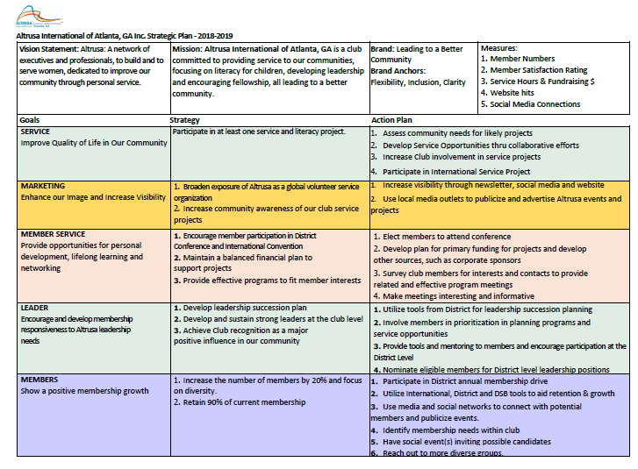
Sample One Pager Plan
It doesn’t have to be long, or complicated – the plan is your guide
Download Sample Template
Notes:
Sample template in the leadership toolkit on the leadership tab of the International web site.

Slide 25
Simplifying Support For Our Leaders

Slide 26
Who Are Our Leaders?
You are a leader if you:
Are the lead member on a project
Chair a committee
Serve on a Board
Club
District
Non-profit

Slide 27
How Can We Support Our Leaders?
As a leader you know you can’t do it alone—here are ways we can all support those in leadership roles
Respect their leadership & goals
Communicate with your leader
Be helpful without being asked

Slide 28
How Can We Support Our Leaders?
Keep these Altrusa Principles in mind:
Altrusa is a builder of women.
7. Altrusa develops true leadership, concerned with accomplishment and not with recognition.
Allow your leader to shine.
~ Selection from Aspirations of an Altrusan, Mamie L. Bass, 1924

Slide 29
Your 2019-2021 Leadership Development Team
& Resources

Slide 30
Dona Garretson, Chair
Susy Meier, Vice Chair
Linda Barb
Bev Herzog
Linda Moore
Your 2019-2021 Leadership
Development Committee
Each International Committee has a Chair, Vice Chair, and Members. Please see the International website http://www.Altrusa.org for each committee.

Slide 31
Altrusa@Altrusa.org 1-312-427-4410
Who’s there?
Tanika Wilson, Executive Director
Supervises the overall planning, direction, and coordination of staff activities and programs to insure that the goals and objectives of the Association Board and members are met.
David Mena, Communications Assistant
Maintains and provides support for the International website to ensure content is accurate, relevant and current. Promotes products and services for all International events, designs promotional materials, assists with communication strategies or messages. Also responsible for the production of our publications.
Your International Office

Slide 32
Who’s there?
Carrie Shrader, Accounting Assistant
Manages expense reports, reimbursements, maintaining and reconciling accounts payable and receivable, assists members with membership dues payments, processing payroll, maintains financial reporting and filing of appropriate forms. Also provides support to the International Treasurer as required.
Wyneisha Robinson, Administrative Assistant
Provides support to the Executive Director, employees and members to ensure all interactions between the organization and members are positive and productive. Also Assists members with technical support for Group Tally issues, password issues, and dues-paying issues. Receives, tracks, and files all Club Annual Reports.
Your International Office

Slide 33
Other Resources
Steve Strelsin, https://www.axiomcp.com/idea/simplify-important-leadership-skill/
10 Ways to Simplify Your Leadership https://www.lollydaskal.com/leadership/10-ways-to-simplify-your-leadership/
7 Ways to Develop Leadership Skills While Volunteering https://www.thindifference.com/2017/02/top-7-ways-acquire-leadership-skills-volunteering/

